Slide 1
HCI 557 Computer Graphics and Geometric Modeling
Homework 4 Presentation
BY
Michael Hoefer, Yuanfen Chen, Hsiang Sing Naik

Slide 2
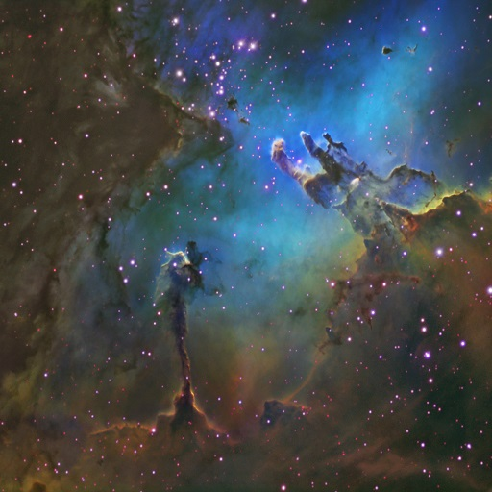

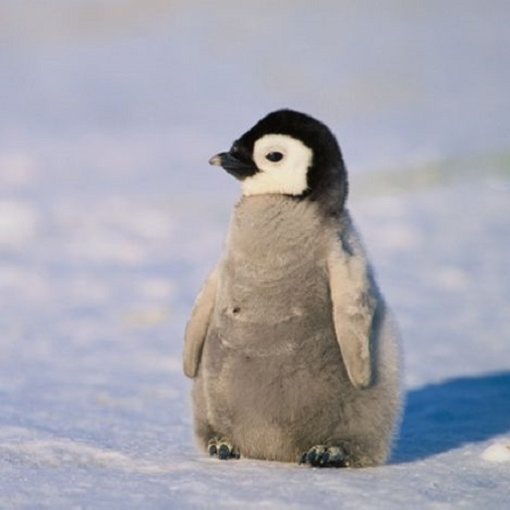
Problem 1
Eagle Nebula (Landscape)
Color Gradient
Penguin (Animal)

Slide 3
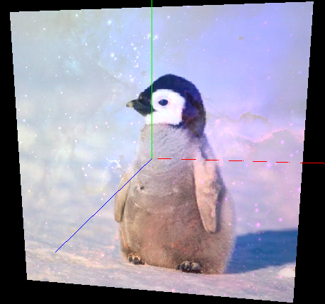
Trial 1
color = (gradient*0.5)*landscape + penguin;

Slide 4
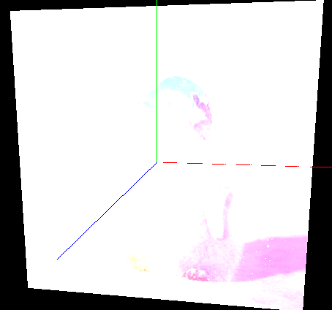
Trial 2
color = 0.1 * pass_Color + tex_gradient + tex_landscape + tex_penguin;

Slide 5
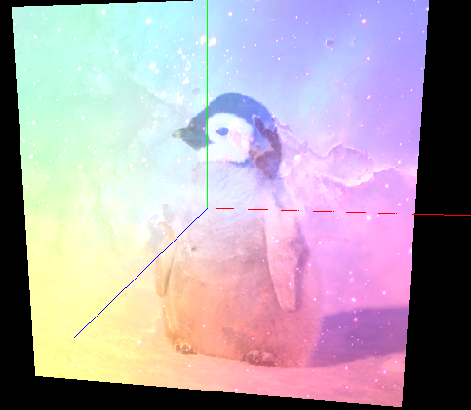
Trial 3
color = 0.1 * pass_Color + 0.5*tex_gradient+0.5*tex_landscape +0.5*tex_penguin;

Slide 6
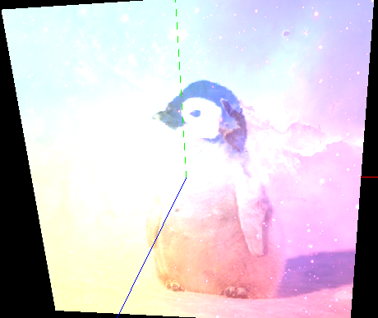
Trial 4
color = 0.1 * pass_Color + 0.5*tex_gradient+0.6*tex_landscape +0.7*tex_penguin;

Slide 7
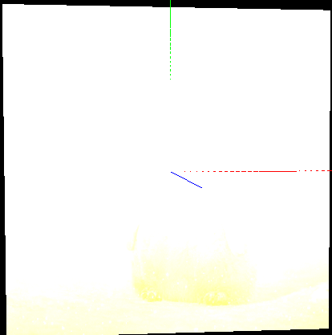
Trial 5
color = pass_Color + 0.5*tex_gradient+0.6*tex_landscape +0.7*tex_penguin;

Slide 8
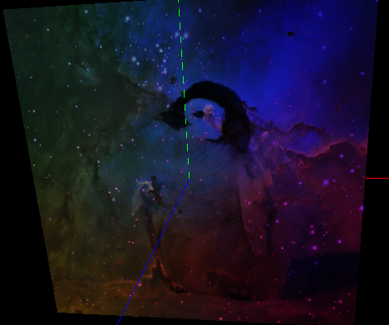
Trial 6
color = tex_landscape * tex_gradient * tex_penguin;
Notes:
which provides a good combination of landscape, gradient, and penguin. Using multiplication ensures that the color values remain lower than any single texture value by itself, so there is no issue with washing out the colors. The image appears darker because the RGB values are all less than one, so multiplication results in less intensity.

Slide 9
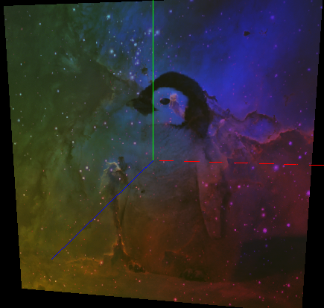
Trial 7
color =pass_Color*0.1 + tex_landscape * tex_gradient * tex_penguin;
Notes:
To increase the brightness, we added in some of the pass_Color of the primitive (white)

Slide 10
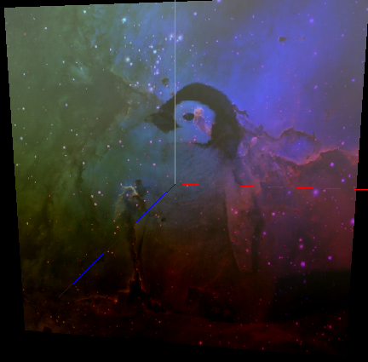
Trial 8
color =pass_Color*0.1 + tex_landscape * tex_gradient * tex_penguin +0.4* tex_gradient.b - 0.4*tex_gradient.r;
Notes:
Next, we experimented with adding and subtracting single color channels of the color gradient. This made the picture brighter in the blue areas and darker in the red areas.

Slide 11
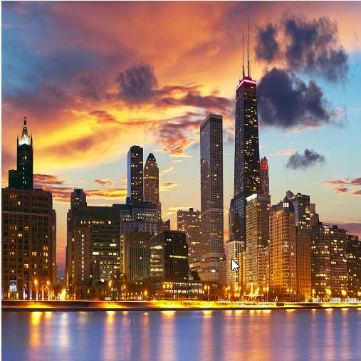
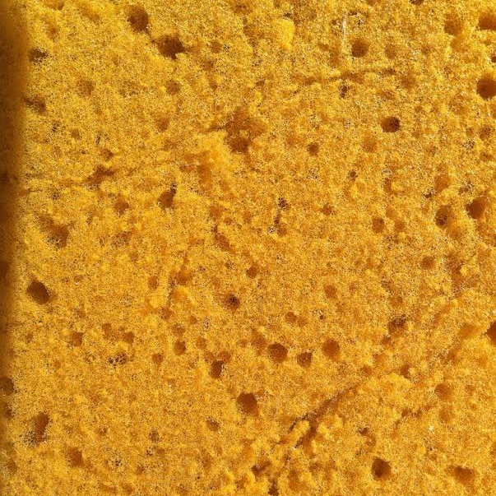
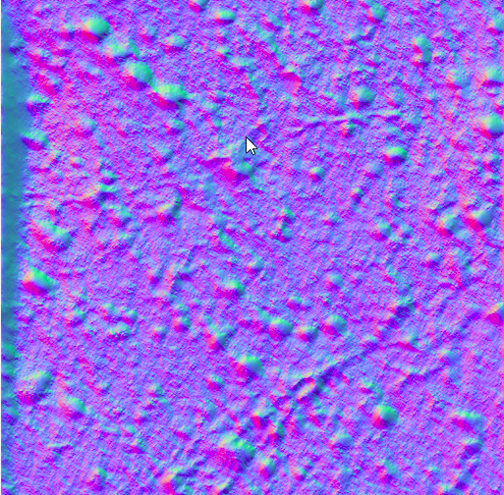
Problem 2
Landscape
Sponge
Noise map of Sponge

Slide 12
Shader file
noiseVec = normalize(texture(noiseMap, pass_TexCoord).xy);
xy(RG), yz (GB), xz(RB)
After normalization, the noiseVec is a vector of 2 with value within 0-1.
noiseVec = (noiseVec * 2.0 - 1.0) * 0.035;
now the noiseVec could be negative(if the original value less than 0.5), which makes it possible for the landscape to shift to every direction.
(+,+) downleft,
(+,-) upleft,
(-,-) upright,
(-,+) downright.
The 0.035 is the scaling factor, which scale down the magnitude of the noise.

Slide 13
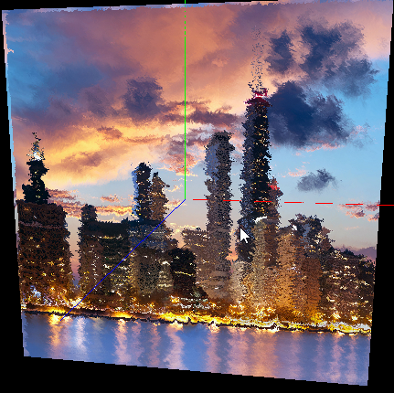
Trial 1
noiseVec = (noiseVec * 2.0 - 1.0) * 0.035;
Y-Z values
Come from
the bottom
Come from
the right
1
0
1
-0.05
0.95
1.05
0.05
Notes:
Using the equation given: noiseVec = (noiseVec * 2.0 - 1.0) * 0.035; and the YZ (GB) values of the noisemap resulted in the following image. The left edge now is actually the right edge in the original figure; the upper edge is actually the down edge in the original. That is because after (noiseVec * 2.0 - 1.0), the noiseVec is negative at the noise map, so the pass_TexCoord + noiseVec became negative, say, -0.05, then it seems the computer add 1 to the negative value, ending in a value close to 1, say 0.095. Same for the upper edge.

Slide 14
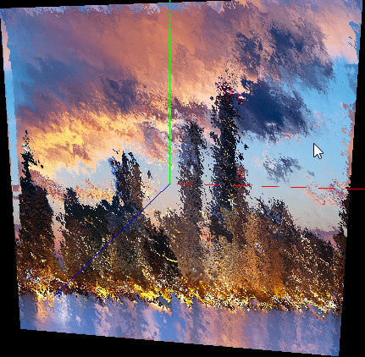
Trial 2
noiseVec = (noiseVec * 2.0 - 1.0) * 0.035;
X-Y values
Notes:
By using the xy values instead yz, the following image is displayed. Using the xy (rg) components of the noisemap makes the noisiest image. This is likely because the red >blue >green, in the noisemap image, so the distortion is higher.

Slide 15
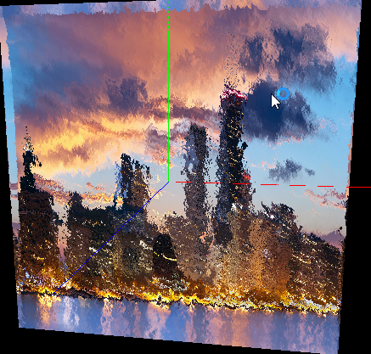
Trial 3
noiseVec = (noiseVec * 2.0 - 1.0) * 0.035;
X-Z values
Notes:
Same for xz(rb),the noisemap makes the noisiest image

Slide 16
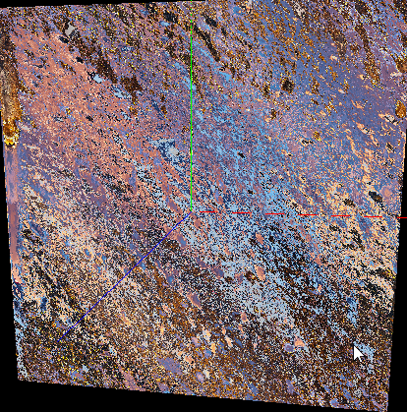
Trial 4
noiseVec = (noiseVec * 2.0 - 1.0) * 0.5;
X-Y values

Slide 17
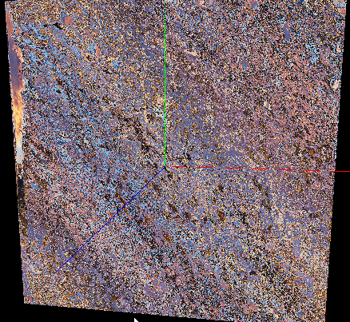
Trial 5
noiseVec = (noiseVec * 2.0 - 1.0) * 1;
X-Y values

Slide 18
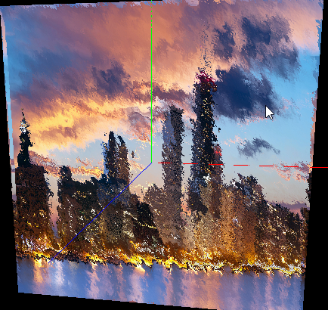
Trial 6
noiseVec = (noiseVec * 2.0 - 1.0) * 0.02;

Slide 19
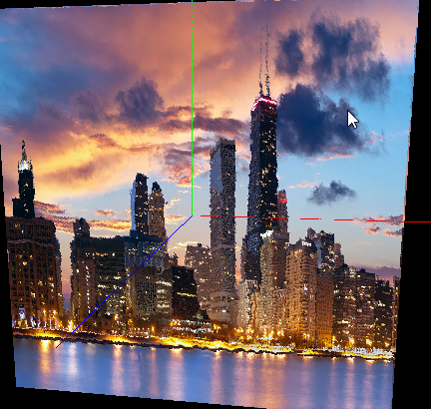
Trial 7
noiseVec = (noiseVec * 2.0 - 1.0) * 0.005;

Slide 20
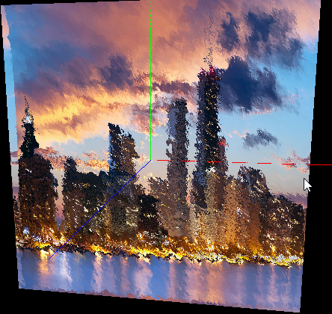
Trial 8
noiseVec = (noiseVec * 1.0 - 1.0) * 0.035;

Slide 21
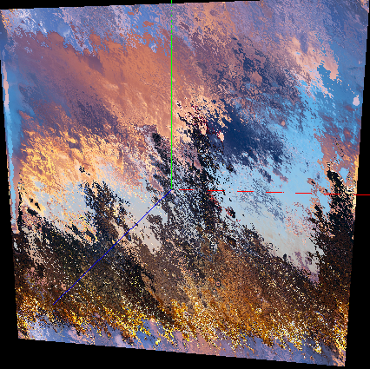
Trial 9
noiseVec = (noiseVec * 1.0 - 1.0) * 0.035;

Slide 22
Trial 10
noiseVec = (noiseVec * 5.0 - 1.0) * 0.035;

Slide 23
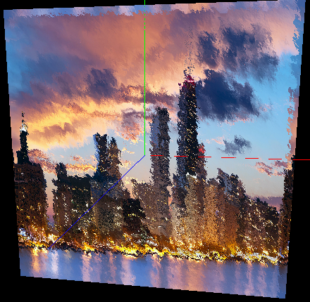
Trial 11
noiseVec = (noiseVec) * 0.035;

Slide 24
Questions?

